Slide 1
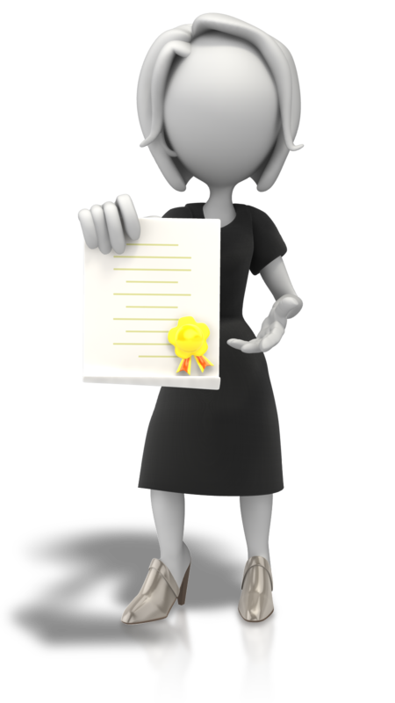
Proud Moments

Slide 2
Proud Moments
A proud moment is a time when you feel pleased with what you have done.
Remembering these moments will inspire you and create a positive feeling
The times you’re proud are the times you play to your strengths.
For example, going to a friend’s birthday party when you don’t feel like it, shows you’re a caring person who puts others before themselves

Slide 3
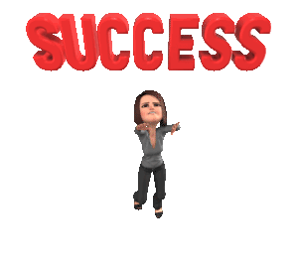
Proud moments can be when you’ve stretched yourself
Perhaps you’ve done something really scary – a talk to people.
What made you do this? Was it because you wanted to get the message out?
In this example you would be a courageous person

Slide 4
Recognition
You can be proud also of accolades or recognition.
Reflect on these times, as it gives insight into yourself.
Even the simple thank you’s - reflect on why were you given these.

Slide 5
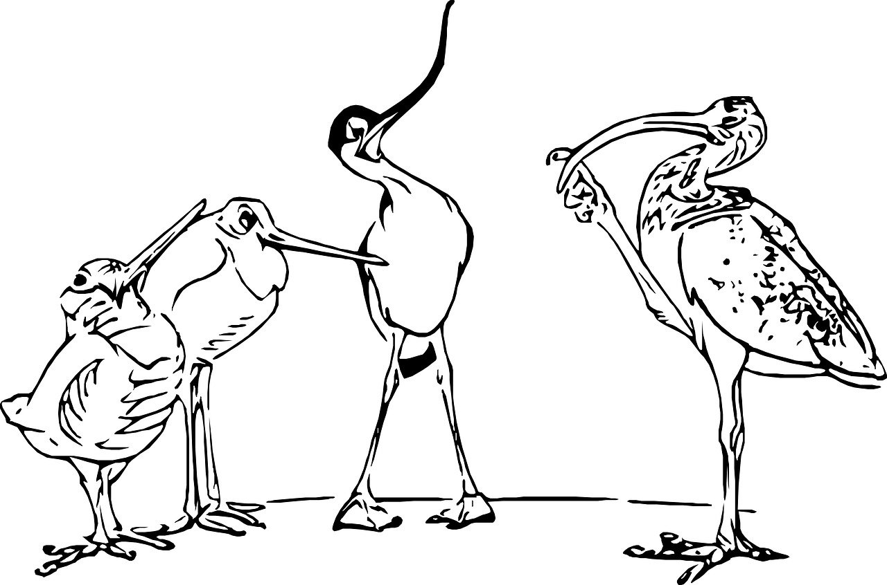
Exercise 1
Think about the things you’ve done so far in your life that you’re proud of They don’t have to be big things or major achievements.
They can be as simple as if you were kind to the lonely next-door neighbour or you kept going in difficult circumstances.
As you think of things this week, make a note of them

