Slide 1
Dealing with Challenging People
Part 2 – Building Trust

Slide 2
What happens when you lose Trust?
We withdraw energy
We lose engagement
We go on Internal strike
Notes:
Trust is hard to define, but we do know when it’s lost. When that happens, we withdraw our energy and level of engagement. We go on an internal strike, not wanting to be sympathetic to the person who we feel has hurt us or treated us wrongly. We may not show it outwardly, but we are less likely to tell the formerly trusted person that we are upset, to share what is important to us or to follow through on commitments. As a result, we pull back from that person and no longer feel part of their world. This loss of trust can be obvious or somewhat hidden — especially if we pretend to be present but inwardly disengage. And those who have done something to lose our trust may not even know it.
On the positive side, trust makes people feel eager to be part of a relationship or group, with a shared purpose and a willingness to depend on each other. When trust is intact, we will willingly contribute what is needed, not just by offering our presence, but also by sharing our dedication, talent, energy and honest thoughts on how the relationship or group is working.
One dictionary definition of trust is “feeling safe when vulnerable.” When we depend on a leader, family member or friend, we can feel vulnerable, and we need trust to manage the anxiety of this feeling. When trust is present, things go well; but when trust is lost, the relationship is at risk.

Slide 3
The 5 Activities to build Trust in your Team
“There’s no team without trust”
Google’s study found that trust, in the form of psychological safety, is the greatest indicator of team performance.
Psychological safety can be defined as the belief that one is free to be themselves without repercussions
Visit https://www.workstyle.io/team-trust-building-activities
Notes:
There’s no team without trust” - These are the famous words of Paul Santanga, Head of Industry at Google, after a two-year-long study on team performance.
Psychological safety can be defined as the belief that one is free to be themselves without repercussions and to not be punished after making an honest mistake.
https://www.workstyle.io/team-trust-building-activities

Slide 4
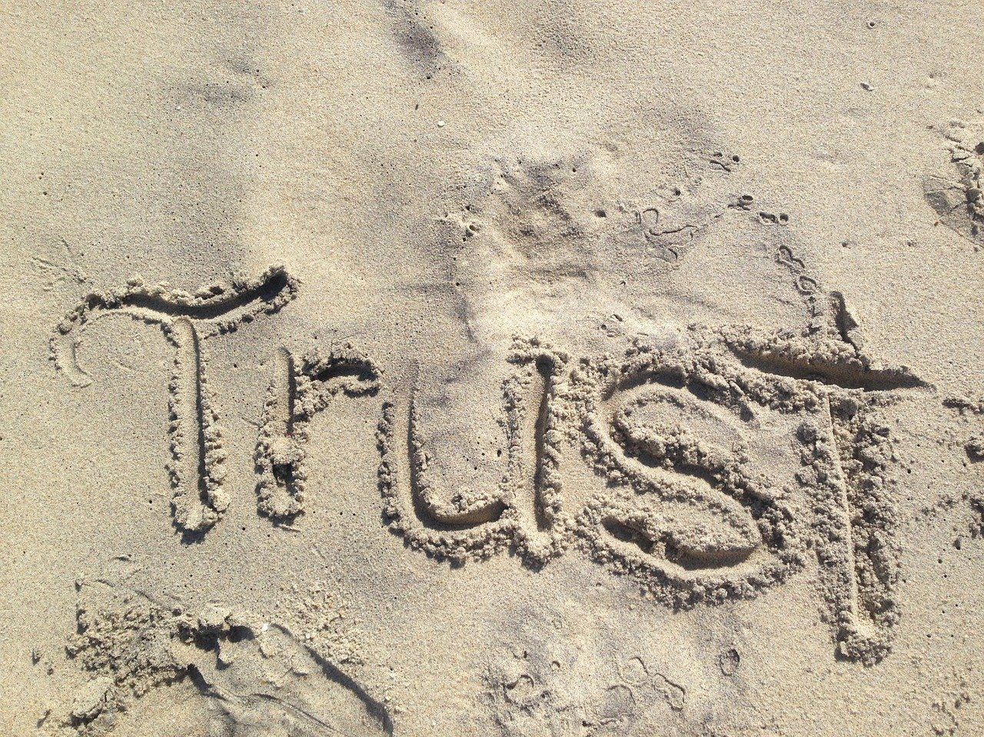
Would you say there is deep trust within your teams for each other?
If not, what needs to change?
How could you help the team build trust with each other and you?
Notes:
Think about your Team and the questions above.

